Slide 1
NorthWind Quiz
Neo4j
k. Anju Munoth

Slide 2
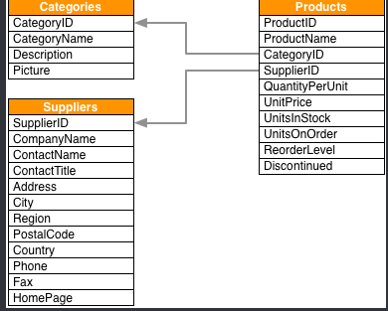

Slide 3
Load product data.
LOAD CSV WITH HEADERS FROM "https://data.neo4j.com/northwind/products.csv" AS row
CREATE (n:Product)
SET n = row,
n.unitPrice = toFloat(row.unitPrice),
n.unitsInStock = toInteger(row.unitsInStock), n.unitsOnOrder = toInteger(row.unitsOnOrder),
n.reorderLevel = toInteger(row.reorderLevel), n.discontinued = (row.discontinued <> "0")

Slide 4
Load category data.
LOAD CSV WITH HEADERS FROM "https://data.neo4j.com/northwind/categories.csv" AS row
CREATE (n:Category)
SET n = row

Slide 5
Load supplier data.
LOAD CSV WITH HEADERS FROM "https://data.neo4j.com/northwind/suppliers.csv" AS row
CREATE (n:Supplier)
SET n = row

Slide 6
Create node indexes based on labels
CREATE INDEX FOR (p:Product) ON (p.productID)

Slide 7
Create node indexes based on labels
CREATE INDEX FOR (p:Product) ON (p.productName)

Slide 8
Create node indexes based on labels
CREATE INDEX FOR (c:Category) ON (c.categoryID)

Slide 9
Create node indexes based on labels
CREATE INDEX FOR (s:Supplier) ON (s.supplierID)

Slide 10
Relate product catalog data Transform foreign key references into data relationships
MATCH (p:Product),(c:Category)
WHERE p.categoryID = c.categoryID
CREATE (p)-[:PART_OF]->(c)

Slide 11
Relate product catalog data Transform foreign key references into data relationships
MATCH (p:Product),(s:Supplier)
WHERE p.supplierID = s.supplierID
CREATE (s)-[:SUPPLIES]->(p)

Slide 12
What categories of food does each supplier supply?
MATCH (s:Supplier)-->(:Product)-->(c:Category)
RETURN s.companyName as Company, collect(distinct c.categoryName) as Categories

Slide 13
Find the produce suppliers.
MATCH (c:Category {categoryName:"Produce"})<--(:Product)<--(s:Supplier)
RETURN DISTINCT s.companyName as ProduceSuppliers

Slide 14
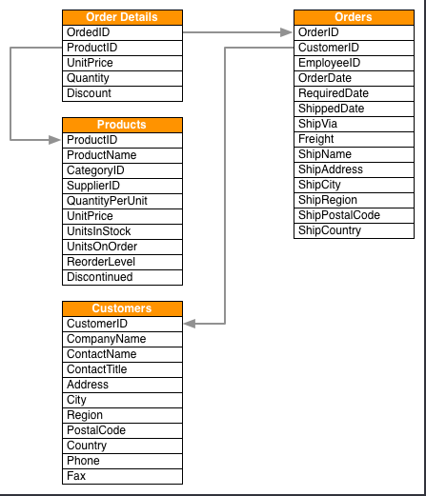

Slide 15
Load customer data.
LOAD CSV WITH HEADERS FROM "https://data.neo4j.com/northwind/customers.csv" AS row
CREATE (n:Customer)
SET n = row

Slide 16
Load order data.
LOAD CSV WITH HEADERS FROM "https://data.neo4j.com/northwind/orders.csv" AS row
CREATE (n:Order)
SET n = row

Slide 17
Index customer orders data
CREATE INDEX FOR (n:Customer) ON (n.customerID)
CREATE INDEX FOR (o:Order) ON (o.orderID)

Slide 18
Create releationships between customers and orders
MATCH (n:Customer),(o:Order)
WHERE n.customerID = o.customerID
CREATE (n)-[:PURCHASED]->(o)

Slide 19
Promote customer orders data Transform join records into relationships
LOAD CSV WITH HEADERS FROM "https://data.neo4j.com/northwind/order-details.csv" AS row
MATCH (p:Product), (o:Order)
WHERE p.productID = row.productID AND o.orderID = row.orderID
CREATE (o)-[details:ORDERS]->(p)
SET details = row,
details.quantity = toInteger(row.quantity)

Slide 20
How many products did each customer purchase?
MATCH (cust:Customer)-[:PURCHASED]->(:Order)-[o:ORDERS]->(p:Product),
(p)-[:PART_OF]->(c:Category {categoryName:"Produce"})
RETURN DISTINCT cust.contactName as CustomerName, SUM(o.quantity) AS TotalProductsPurchased

